Slide 1
A Study of Malware on the Gnutella Network using LimeWire
Fall 2008: Integrated Research Component
Computer Science 352: Computer Security
Professor: Oberta Slotterbeck
By: Matthew Young

Slide 2
Project Description - Overview
Create a program that will download sample data from the Gnutella network with varying file sizes and file types using a number of different queries.
Scan this sample data for malware. Scanning the files based on the queries used and the type of file.
Analyze the results of the scans and drawing conclusions based on these results.

Slide 3
Why this Project?
Peer-to-Peer (P2P) file sharing is a rapidly growing area where new users often do not completely understand the risks they are taking.
As a user of P2P file sharing programs it was interesting to see the types of files being shared and how much malware there was on these networks.

Slide 4
Why LimeWire?
LimeWire is free and open-source.
LimeWire is the most popular P2P and file-sharing program with over 160 million downloads.
LimeWire is a Peer-to-Peer client that uses the Gnutella network to find and share files.

Slide 5
Gathering the Data
There were several constants decided on before any files were downloaded.
25 different keywords.
30 files for each query.
Any file type between 1 and 5,000 KB’s.
Along with the files themselves, the runtimes and the total number of search results were also saved after each search.

Slide 6
Keywords
Keywords were picked to fit one of four broader categories.
  Movies
  Music
  Software and OS’s
  Video Games
Movies, Music and Video Games each had five keyword’s, while Software and OS’s had ten.
Keywords were chosen based on a number of different criteria. Recent and popular movies, music, and video games were used, and software keywords were chosen from CNET’s most popular Windows downloads list.

Slide 7
Keyword List
Movies
Indiana Jones
Iron Man
Quantum of Solace
The Dark Knight
WALL-E
Music
AC/DC
Coldplay
Lil Wayne
Metallica
Rihanna
Video Games
Call of Duty
Dead Space
Fallout
The Sims
Warcraft
Software – OS’s
Adobe AVG LimeWire Linux
Mcafee MSN Office OSX
Windows WinZip

Slide 8
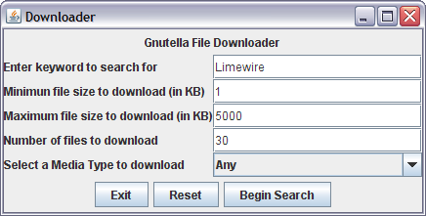
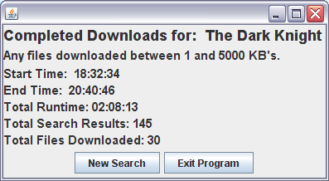
Gathering Data – The Downloader
The Downloader allows the user to input Keyword, minimum and maximum file sizes, the number of and type of files to be downloaded.
After beginning the search, the downloader will automatically download the files, and once complete, display the results.

Slide 9
Gathering Data - Results
Total of 750 files downloaded from the 1900 search results.
The total runtime for the downloader was 22 hours, 20 minuets, and 3 seconds.
The 750 files took up a total of 778 MB, with 254 Audio/Video files, 430 Zipped files, and 66 Others ranging from JPEG’s to Torrent files.

Slide 10
Analyzing the Data – By File Type
Of the 750 files that were downloaded, 434 or 58% contained an infection of some type.
There were a total of 30 different threats.
Of these, 396 (91%) of the infections were from Zipped files, with the remaining 38 (9%) of infections being found in Audio/Video files.
The “Others” file type contained no malware.

Slide 11
Analyzing the Data - By Query Type
255 or 59% of infected files came from the Software and OS’s queries.
100 or 23% of infected files came from Movie queries.
72 or 16% of infected files came from Video Game queries.
7 or 2% of infected files came from Music queries.

Slide 12
Infections Found
Trojan-Downloader.WMA.GetCodec.b
Trojan-Downloader.Win32.VB.bsa
Trojan.Win32.Buzus.adbl
P2P-Worm.Win32.VB.dw
Virus.Win32.Sality.v
AdWare.Win32.Agent.dva
Trojan.Win32.Agent.uvi
Trojan-Dropper.Win32.VB.gtf
Backdoor.Win32.IRCBot.dd
Trojan.Win32.VB.eme
Virus.Win32.Fontra.c
P2P-Worm.Win32.Agent.bm
Trojan.Win32.Obfuscated.gen
Trojan-Downloader.Win32.VB.dck
Trojan-Downloader.Win32.VB.dck was by far the most common infection found, making up over 50% of the total.

Slide 13
Conclusions
Zipped files are the most likely to contain malware, with 396 of the 430 files downloaded being infected (92%).
While no queries were completely safe, Music searches resulted in the least amount of malware with only 7 of the 150 downloaded files being infected (5%).
Audio and Video files are not immune to infection, 38 of the 254 Audio/Video files downloaded were infected (15%).

Slide 14
Conclusions Continued
Of the 66 “Other” file types downloaded, there were no infections found in any.
Queries for Software or OS’s were the most likely to return an infected file, with 255 of the 300 files downloaded being infected (85%).
Do not download 113KB Zip files. 223 of the 224 files this size contained the Trojan-Downloader.Win32.VB.dck (99.5%).

